Slide 1

Unit-04.1 Modules
Python Programming(2101CS405)
Prof. Jayesh D. Vagadiya
Computer Engineering Department
Jayesh.vagadiya@darshan.ac.in
9537133260

Slide 2

Outline
Importing a module
Math module
Random module
Datetime module
Creating a custom module.
Examples
Looping

Slide 3
Introduction
Modules provide a means of collecting sets of functions together so that they can be used by any number of programs.
A Python module, simply put, is a .py file.
A module can contain any Python code we like. All the programs we have written so far have been contained in a single .py file, and so they are modules as well as programs.
The key difference is that programs are designed to be run, whereas modules are designed to be imported and used by programs.
Not all modules have associated .py files—for example, the sys module is built into Python, and some modules are written in other languages (most commonly, C).
It makes no difference to our programs what language a module is written in, since all modules are imported and used in the same way.

Slide 4
packages
A package can contain one or more relevant modules.
A package is basically a directory with Python files and a file with the name __init__.py.
This means that every directory inside of the Python path, which contains a file named __init__.py, will be treated as a package by Python.
__init__.py
Module1.py
My APP
My Package
Module1.py

Slide 5
Importing a module
import statement is used for importing module and packages.
Here importable is module, package or a module in a package.
The first syntax is used to import one module at a time and second syntax is used to import multiple module at same time.
The third syntax allows us to give a name of our choice to the package or module.
Theoretically this could lead to name clashes, but in practice the as syntax is used to avoid them.
Renaming is particularly useful when experimenting with different implementations of a module.
syntax
import importable
import importable1, importable2, ..., importableN
import importable as preferred_name

Slide 6
Importing a module (cont.)
For example, if we had two modules MyModuleA and MyModuleB that had the same API (Application Programming Interface), we could write import MyModuleA as MyModule in a program, and later on seamlessly switch to using import MyModuleB as MyModule.
It is common practice to put all the import statements at the beginning of .py files
Example.py
1
2
3
4
5
# import random
import random
list1 = [10,232,23,45,34]
print(random.choice(list1))
OUTPUT
45

Slide 7
Random Module
Python has a built-in module that provide set of function by which we can generate random numbers.
These are pseudo-random numbers means these are not truly random.
random()
It is used to generate random numbers in Python.
It generate random float number.
It generate pseudo-random numbers. That means these randomly generated numbers can be determined.
syntax
import random
Example.py
OUTPUT
1
2
3
4
5
# import random
import random
print("Random 1=",random.random())
print("Random 2=",random.random())
Random 1= 0.14738964825362189
Random 2= 0.48730431196440027

Slide 8
Random Module (cont.)
seed()
random() function generates numbers for some values. This value is also called seed value.
Seed function is used to save the state of a random function, so that it can generate same random numbers on multiple executions of the code on the same machine.
Example.py
OUTPUT
1
2
3
4
5
6
# import random
import random
random.seed(3) print("Random 1=",random.random())
print("Random 2=",random.random())
Random 1= 0.23796462709189137
Random 2= 0.5442292252959519

Slide 9
Random Module (cont.)
randint()
This method return a random integer number between two range.
randrange()
This method return a random integer number from the range created by the start, stop and step arguments.
The value of start is 0 by default. Similarly, the value of step is 1 by default.
Example.py
OUTPUT
1
2
3
4
5
# import random
import random
print("Random 1=",random.randint(1, 100))
print("Random 2=",random.randint(1, 100))
Random 1= 80
Random 2= 39
Example.py
OUTPUT
1
2
3
4
5
6
# import random
import random
#random.ranage(start,stop,step)
print("Random 1=",random.randrange(0, 100,10))
print("Random 2=",random.randrange(1, 100,2))
Random 1= 80
Random 2= 39

Slide 10
Random Module (cont.)
choice():
Method returns a randomly selected element from a non-empty sequence.
shuffle():
Method randomly reorders the elements in a list.
Example.py
OUTPUT
1
2
3
4
5
6
7
# import random
import random
list1 = [10,232,23,45,34]
t1 = (10,232,23,45,34)
print(random.choice(list1))
print(random.choice(t1))
34
23
Example.py
OUTPUT
1
2
3
4
5
6
# import random
import random
list1 = [10,232,23,45,34]
random.shuffle(list1)
print(list1)
[45, 34, 23, 232, 10]

Slide 11
Random Module (cont.)
uniform()
This method generate random floating point number between two given range.
Example.py
OUTPUT
1
2
3
4
5
6
# import random
import random
#random.ranage(start,stop,step)
print("Random 1=",random.uniform(2,9))
print("Random 2=",random.uniform(10,20))
Random 1= 8.079151436715527
Random 2= 15.767192676676762

Slide 12
Math Module
This module provides access to the mathematical functions.
This module provides set of methods and constants.
Constants provided by the math module are
Euler’s Number
Pi
Tau
Infinity
Not a Number (NaN)
Example.py
OUTPUT
1
2
3
4
5
6
7
import math
print("e = ", math.e)
print("PI = ", math.pi)
print("Tau = ", math.tau)
print("infinity = ", math.inf)
print("NaN = ", math.nan)
e = 2.718281828459045
PI = 3.141592653589793
Tau = 6.283185307179586
infinity = inf
NaN = nan

Slide 13
Numeric Functions
ceil() and floor()
Ceil value means the smallest integral value greater than the number and the floor value means the greatest integral value smaller than the number.
this can be easily calculated using the ceil() and floor() method respectively.
factorial()
It is used to find factorial of given number.
Example.py
OUTPUT
1
2
3
4
5
import math
n = 5.6
print("Ceil = ",math.ceil(n))
print("Floor = ",math.floor(n))
Ceil = 6
Floor = 5
Example.py
OUTPUT
1
2
3
4
5
import math
n = 5
fact = math.factorial(n)
print("Factorial = ",fact)
Factorial = 120

Slide 14
Numeric Functions(cont.)
gcd()
It is used find greatest common divisor of two number passed as argument.
fabs()
This function return the absolute value of given number.
Example.py
OUTPUT
1
2
3
4
5
import math
a = 15
b = 30
print("GCD = ",math.gcd(a,b))
GCD = 15
Example.py
OUTPUT
1
2
3
4
import math
n = -15
print("absolute = ",math.fabs(n))
absolute = 15.0

Slide 15
Logarithmic and Power Functions
Function | Description | Example | Output
exp(x) | Return e raised to the power x | math.exp(1) | 2.718281828459045
pow(x, y) | Return x raised to the power y (x**y) | math.pow(5,3) | 125.0
log(x[, base]) | With two arguments, return the logarithm of x to the given base | math.log(10,2) | 3.3219280948873626
log2(x) | Return the base-2 logarithm of x | math.log2(10) | 3.3219280948873626
log10(x) | Return the base-10 logarithm of x | math.log10(10) | 1.0
sqrt(x) | Return the square root of x | math.sqrt(81) | 9.0

Slide 16
Trigonometric and Angular Functions
Function | Description | Example | Output
sin(x) | Return the sine of x radians. | math.sin(1) | 0.8414709848078965
cos(x) | Return the cosine of x radians. | math.cos(1) | 0.5403023058681398
tan(x) | Return the tangent of x radians. | math.tan(1) | 1.557407724654902
degrees() | Convert angle x from radians to degrees. | math.radians(90) | 1.5707963267948966
radians() | Convert angle x from degrees to radians. | math.degrees(1.5) | 85.94366926962348

Slide 17
Special Functions
Function | Description | Example | Output
gamma(x) | Return the gamma value of x. | math.gamma(6) | 120.0
isinf() | check whether the value is infinity or not. | math.isinf(math.pi) | False
isnan() | check whether the value is NaN or not. | math.isnan(float('nan')) | True
erf(x) | Return the error function at x. | math.erf(5) | 0.9999999999984626

Slide 18
Date Time Module
The datetime module supplies classes for manipulating dates and times.
These classes provide a number of functions to deal with dates, times and time intervals.
Date and datetime are an object in Python, so when you manipulate them, you are actually manipulating objects and not string or timestamps.
Classes | Description
date | An idealized naive date. Attributes: year, month, and day.
time | An idealized time. Attributes: hour, minute, second, microsecond, and tzinfo.
datetime | A combination of a date and a time. Attributes: year, month, day, hour, minute, second, microsecond, and tzinfo.
timedelta | A duration expressing the difference between two date, time, or datetime instances
tzinfo | An abstract base class for time zone information objects.
timezone | A class that implements the tzinfo abstract base class as a fixed offset from the UTC.

Slide 19
Date Time Module (cont.)
The datetime module exports the following constants:
MINYEAR – value is 1
MAXYEAR – value is 9999

Slide 20
date class
The date class is used to instantiate date objects in Python. When an object of this class is instantiated, it represents a date in the format YYYY-MM-DD.
Constructor of this class needs three mandatory arguments year, month and date.
syntax
Example.py
datetime.date(year, month, day)
1
2
3
4
5
6
import datetime
# print today date
d = datetime.date.today()
print("Date = ",d.day)
print("Month = ",d.month)
print("Year = ",d.year)
Example.py
Example.py
1
2
3
4
import datetime
d = datetime.date(1879,4,14)
print("Birthday=",d)
1
2
3
4
import datetime
# print today date
d = datetime.date.today()
print("Today ",d)
OUTPUT
OUTPUT
OUTPUT
Date = 31
Month = 12
Year = 2021
Birthday 1879-04-14
Today 2021-12-31

Slide 21
time class
The time class creates the time object which represents local time, independent of any day.
syntax
datetime.time(hour, minute, second, microsecond=0, tzinfo=None, *, fold=0)
Example.py
Example.py
1
2
3
4
import datetime
t = datetime.time(10,40,30) print("Time=",t)
1
2
3
4
5
6
7
import datetime
t = datetime.time(10,40,30) print("hour =",t.hour)
print("minute =",t.minute)
print("second =",t.second)
print("microsecond= ",t.microsecond)
OUTPUT
Time= 10:40:30
OUTPUT
hour = 10
minute = 40
second = 30
microsecond = 0

Slide 22
Datetime class
The DateTime class contains information on both date and time.
syntax
datetime.datetime(year, month, day, hour=0, minute=0, second=0, microsecond=0, tzinfo=None, *,fold=0)
Example.py
Example.py
1
2
3
4
5
6
7
8
import datetime
a = datetime.datetime(1999, 12, 12, 12, 12, 12)
print("year =", a.year)
print("month =", a.month)
print("hour =", a.hour)
print("minute =", a.minute)
print("timestamp =", a.timestamp())
1
2
3
4
import datetime
today = datetime.datetime.now()
print("Current ", today)
OUTPUT
Current 2021-12-31 23:10:42.397856
OUTPUT
year = 1999
month = 12
hour = 12
minute = 12
timestamp = 944980932.0

Slide 23
Timedelta class
Python timedelta class is used for calculating differences in dates and also can be used for date manipulations in Python.
syntax
datetime.timedelta(days=0, seconds=0, microseconds=0, milliseconds=0, minutes=0, hours=0, weeks=0)
Example.py
Example.py
1
2
3
4
5
6
import datetime
today = datetime.datetime.now()
df2 = today + datetime.timedelta(days=2)
print("Current ", today)
print("After 2 days ", df2)
1
2
3
4
5
6
7
8
import datetime
today = datetime.datetime.now()
df2 = today + datetime.timedelta(days=2)
td = df2 - today
print("Current ", today)
print("After 2 days ", df2)
print("difference ", td)
OUTPUT
Current 2021-12-31 23:10:42.397856
OUTPUT
After 2 days 2022-01-02 23:22:24.550069
difference 2 days, 0:00:00

Slide 24
Format Datetime
strftime()and strptime() method converts the given date, time or datetime object to the a string representation of the given format or visa versa.
Example.py
OUTPUT
1
2
3
4
5
6
7
8
9
10
11
12
13
14
15
import datetime
my_string = str(input('Enter date(yyyy-mm-dd): '))
date1 = datetime.datetime.strptime(my_string, "%Y-%m-%d")
today = datetime.datetime.now()
s = date1.strftime("%A %m %Y")
print('Example 1:', s)
s = today.strftime("%a %m %y")
print('Example 2:', s)
s = today.strftime("%I %p %S")
print('Example 3:', s)
s = today.strftime("%H:%M:%S")
print('Example 4:', s)
Enter date(yyyy-mm-dd): 1995-3-2
Example 1: Thursday 03 1995
Example 2: Fri 12 21
Example 3: 11 PM 38
Example 4: 23:38:38

Slide 25
Creating a custom module
To create a custom module save the file with .py extension.
Now we can use the module we just created, by using the import statement.
MyModule.py
1
2
3
4
# module contain Addition function
def Addition(a,b):
return a+b
Example.py
OUTPUT
1
2
3
4
import MyModule
# function call
print("Add=",MyModule.Addition(3,4))
Add= 7

Slide 26
Variables in module
The module can contain functions, as already described, but also variables of all types
We can use them by modulename.variableName in our program.
MyModule.py
1
2
3
4
5
# module contain Addition function
list = [1,2,3,4,5,6,7,8,9] def Addition(a,b):
return a+b
Example.py
OUTPUT
1
2
3
4
5
6
import MyModule
# function call
print("Add=",MyModule.Addition(3,4))
# print list data
print("List=", MyModule.list)
Add= 7
List= [1, 2, 3, 4, 5, 6, 7, 8, 9]

Slide 27
Import From Module
We can choose to import only parts from a module, by using the from keyword.
Sometimes we don't required entire module and we want to use only some of the functions from modules.
This can be archived by from keyword with import.
When importing using the from keyword, do not use the module name when referring to elements in the module.
Example.py
MyModule.py
1
2
3
4
from MyModule import list
# print list data
print("List=", list)
1
2
3
4
5
# module contain Addition function
list = [1,2,3,4,5,6,7,8,9] def Addition(a,b):
return a+b
OUTPUT
List= [1, 2, 3, 4, 5, 6, 7, 8, 9]

Slide 28
Creating custom package
First, we create a directory and give it a package name, preferably related to its operation
Then we put the classes and the required functions in it.
Finally we create an __init__.py file inside the directory, to let Python know that the directory is a package.
MyModule.py
1
2
3
4
5
# module contain Addition function
list = [1,2,3,4,5,6,7,8,9] def Addition(a,b):
return a+b
Package1
__init_.py
Example.py
1
2
3
4
import Package1.MyModule
# print list data
print("List=", Package1.MyModule.list)
MyModule.py
OUTPUT
List= [1, 2, 3, 4, 5, 6, 7, 8, 9]

Slide 29
Unit-04.2 Matplotlib
Python Programming(2101CS405)
Prof. Jayesh D. Vagadiya
Computer Engineering Department
Jayesh.vagadiya@darshan.ac.in
9537133260

Slide 30

Outline
Introduction to MatPlotLib
Graph
Plot
Drawing Multiple Lines and Plots
Export graphs/plots to Image/PDF/SVG
Axis, Ticks ad Grids
Line Appearance
Labels, Annotation, Legends
Types of Graphs
Pie Chart
Bar Chart
Histograms
Boxplots
Scatterplots
Time Series
Plotting Geographical data
Looping

Slide 31
Introduction to MatPlotLib
Most people visualize information better when they see it in graphic versus textual format.
Graphics help people see relationships and make comparisons with greater ease.
Fortunately, python makes the task of converting textual data into graphics relatively easy using libraries, one of most commonly used library for this is MatPlotLib.
Matplotlib is a comprehensive library for creating static, animated, and interactive visualizations in Python.

Slide 32




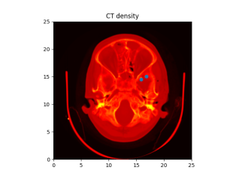
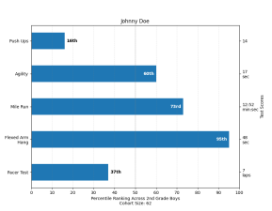
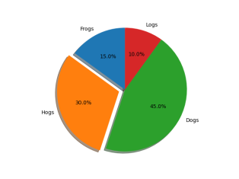
Graph
A Graph or chart is simply a visual representation of numeric data.
MatPlotLib makes a large number of graph and chart types.
We can choose any of the common graph such as line charts, histogram, scatter plots etc....
Line Chart
Histogram
Scatter Plot
3D Plot
Images
Bar Chart
Pie Chart
Etc.......

Slide 33
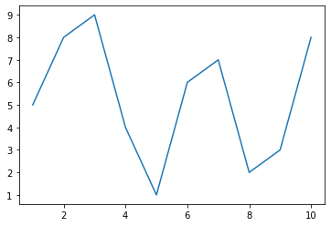
Plot
To define a plot, we need some values, the matplotlib.pyplot module and an idea of what we want to display.
In this case, the code tells the plt.plot() function to create a plot using x-axis between 1 and 11 and y-axis as per values list.
plotDemo1.py
1
2
3
4
5
import matplotlib.pyplot as plt
%matplotlib inline
values = [5,8,9,4,1,6,7,2,3,8]
plt.plot(range(1,11),values)
plt.show()

Slide 34
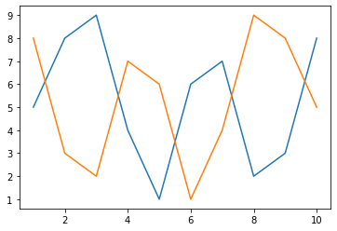
Plot – Drawing multiple lines
We can draw multiple lines in a plot by making multiple plt.plot() calls.
plotDemo1.py
1
2
3
4
5
6
7
import matplotlib.pyplot as plt
%matplotlib inline
values1 = [5,8,9,4,1,6,7,2,3,8]
values2 = [8,3,2,7,6,1,4,9,8,5] plt.plot(range(1,11),values1)
plt.plot(range(1,11),values2)
plt.show()

Slide 35
Plot – Export graphs/plots
We can export/save our plots on a drive using savefig() method.
Possible values for the format parameters are
png
svg
pdf
Etc...
plotDemo1.py
1
2
3
4
5
6
7
8
import matplotlib.pyplot as plt
%matplotlib inline
values1 = [5,8,9,4,1,6,7,2,3,8]
values2 = [8,3,2,7,6,1,4,9,8,5]
plt.plot(range(1,11),values1)
plt.plot(range(1,11),values2)
#plt.show()
plt.savefig('SaveToPath.png',format='png')
SaveToPath.png

Slide 36
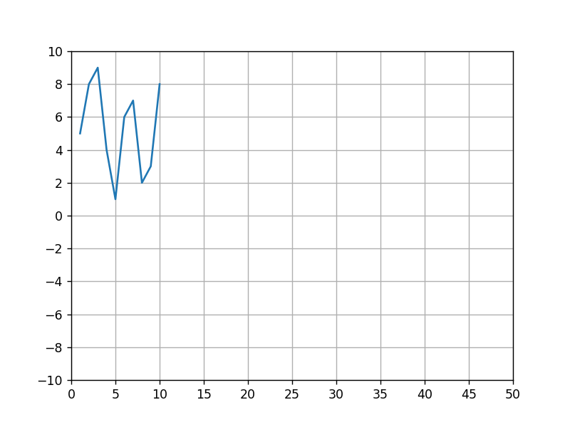
Plot – Axis, Ticks and Grid
We can access and format the axis, ticks and grid on the plot using the axis() method of the matplotlib.pyplot.plt
plotDemo1.py
1
2
3
4
5
6
7
8
9
10
import matplotlib.pyplot as plt
%matplotlib notebook
values = [5,8,9,4,1,6,7,2,3,8]
ax = plt.axes()
ax.set_xlim([0,50])
ax.set_ylim([-10,10])
ax.set_xticks([0,5,10,15,20,25,30,35,40,45,50])
ax.set_yticks([-10,-8,-6,-4,-2,0,2,4,6,8,10])
ax.grid()
plt.plot(range(1,11),values)

Slide 37
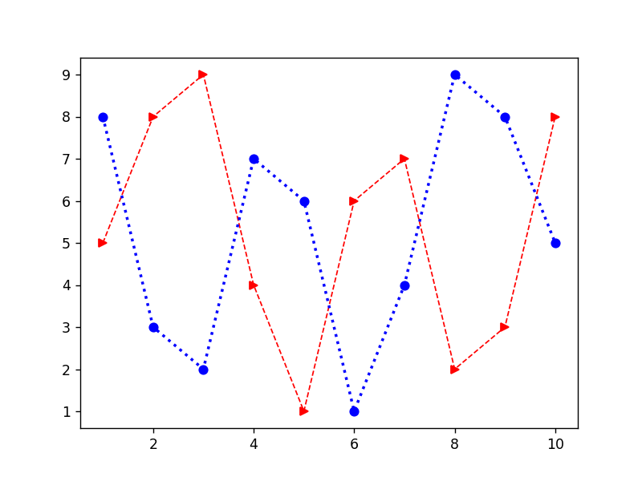
Plot – Line Appearance
We need different line styles in order to differentiate when having multiple lines in the same plot, we can achieve this using many parameters, some of them are listed below.
Line style (linestyle or ls)
Line width (linewidth or lw)
Line color (color or c)
Markers (marker)
plotDemo1.py
1
2
3
4
5
6
7
import matplotlib.pyplot as plt
%matplotlib inline
values1 = [5,8,9,4,1,6,7,2,3,8]
values2 = [8,3,2,7,6,1,4,9,8,5] plt.plot(range(1,11),values1,c='r',lw=1,ls='--',marker='>')
plt.plot(range(1,11),values2,c='b',lw=2,ls=':',marker='o')
plt.show()

Slide 38
Plot – Line Appearance (Cont.)
Possible Values for each parameters are,
Values | Line Style
‘-’ | Solid line
‘--’ | Dashed line
‘-.’ | Dash-dot line
‘:’ | Dotted line
Values | Color
‘b’ | Blue
‘g’ | Green
‘r’ | Red
‘c’ | Cyan
‘m’ | Magenta
‘y’ | Yellow
‘k’ | Black
‘w’ | White
Values | Marker
‘.’ | Point
‘,’ | Pixel
‘o’ | Circle
‘v’ | Triangle down
‘^’ | Triangle up
‘>’ | Triangle right
‘<’ | Triangle left
‘*’ | Star
‘+’ | Plus
‘x’ | X
Etc.......

Slide 39
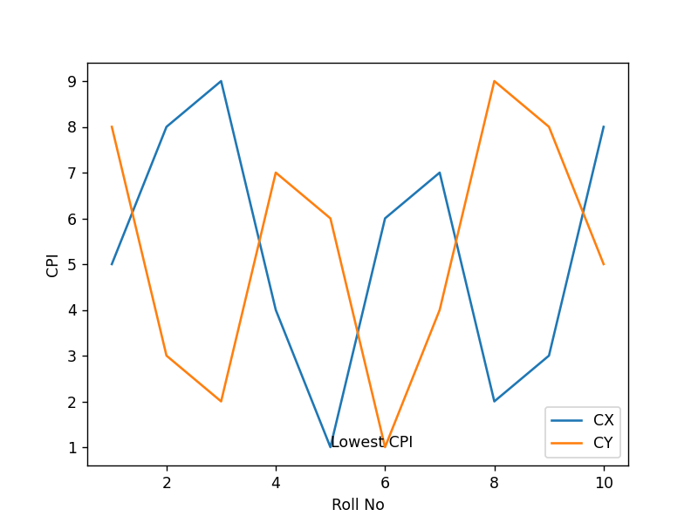
Plot – Labels, Annotation and Legends
To fully document our graph, we have to resort the labels, annotation and legends.
Each of this elements has a different purpose as follows,
Label : provides identification of a particular data element or grouping, it will make easy for viewer to know the name or kind of data illustrated.
Annotation : augments the information the viewer can immediately see about the data with notes, sources or other useful information.
Legend : presents a listing of the data groups within the graph and often provides cues ( such as line type or color) to identify the line with the data.
Y Label
Annotation
Legend
X Label

Slide 40
Plot – Labels, Annotation and Legends (Example)
plotDemo1.py
1
2
3
4
5
6
7
8
9
10
11
import matplotlib.pyplot as plt
%matplotlib inline
values1 = [5,8,9,4,1,6,7,2,3,8]
values2 = [8,3,2,7,6,1,4,9,8,5]
plt.plot(range(1,11),values1)
plt.plot(range(1,11),values2)
plt.xlabel('Roll No')
plt.ylabel('CPI')
plt.annotate(xy=[5,1],s='Lowest CPI')
plt.legend(['CX','CY'],loc=4)
plt.show()

Slide 41
Choosing the Right Graph
The kind of graph we choose determines how people view the associated data, so choosing the right graph from the outset is important.
For example,
if we want to show how various data elements contribute towards a whole, we should use pie chart.
If we want to compare data elements, we should use bar chart.
If we want to show distribution of elements, we should use histograms.
If we want to depict groups in elements, we should use boxplots.
If we want to find patterns in data, we should use scatterplots.
If we want to display trends over time, we should use line chart.
If we want to display geographical data, we should use basemap.
If we want to display network, we should use networkx.
All the above graphs are there in our syllabus and we are going to cover all the graphs in this Unit.
We are also going to cover some other types of libraries which is not in the syllabus like seaborn, plotly, cufflinks and choropleth maps etc..

Slide 42
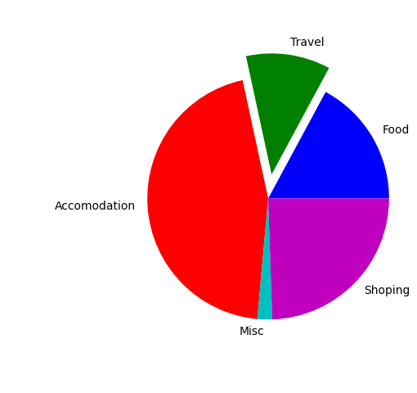
Pie Chart
Pie chart focus on showing parts of a whole, the entire pie would be 100 percentage, the question is how much of that percentage each value occupies.
pieChartDemo.py
1
2
3
4
5
6
7
8
import matplotlib.pyplot as plt
%matplotlib notebook
values = [305,201,805,35,436]
l = ['Food','Travel','Accomodation','Misc','Shoping']
c = ['b','g','r','c','m']
e = [0,0.2,0,0,0]
plt.pie(values,colors=c,labels=l,explode=e)
plt.show()

Slide 43
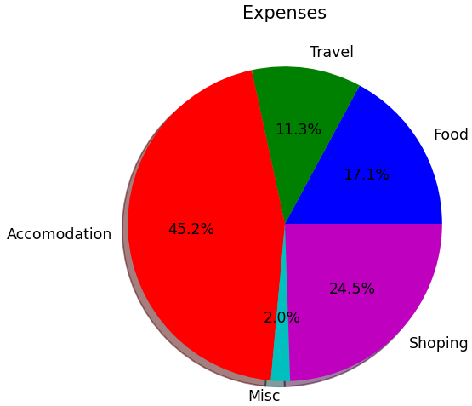
Pie Chart (Cont.)
There are lots of other options available with the pie chart, we are going to cover two important parameters in this slide.
pieChartDemo.py
1
2
3
4
5
6
7
8
import matplotlib.pyplot as plt
%matplotlib notebook
values = [305,201,805,35,436]
l = ['Food','Travel','Accomodation','Misc','Shoping']
c = ['b','g','r','c','m']
plt.pie(values,colors=c,labels=l,shadow=True,
autopct='%1.1f%%')
plt.show()

Slide 44
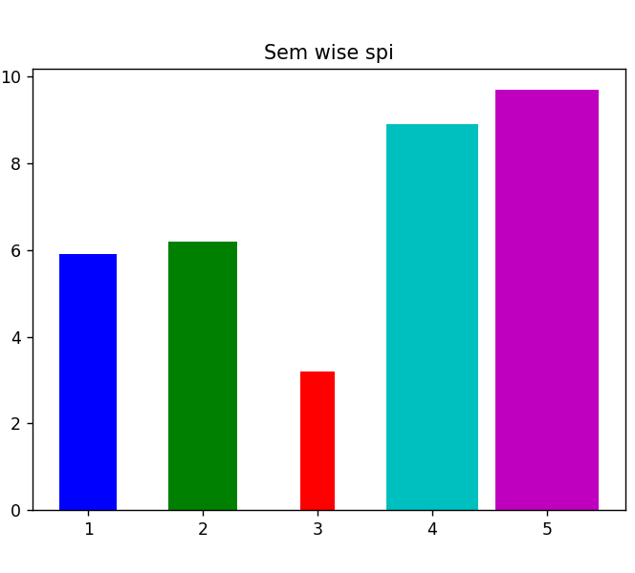
Bar charts
Bar charts make comparing values easy, wide bars an d segregated measurements emphasize the difference between values, rather that the flow of one value to another as a line graph.
Note: you can use barh() function to generate horizontal bar chart.
barChartDemo.py
1
2
3
4
5
6
7
8
9
10
import matplotlib.pyplot as plt
%matplotlib notebook
x = [1,2,3,4,5]
y = [5.9,6.2,3.2,8.9,9.7]
l = ['1st','2nd','3rd','4th','5th']
c = ['b','g','r','c','m']
w = [0.5,0.6,0.3,0.8,0.9]
plt.title('Sem wise spi')
plt.bar(x,y,color=c,label=l,width=w)
plt.show()

Slide 45
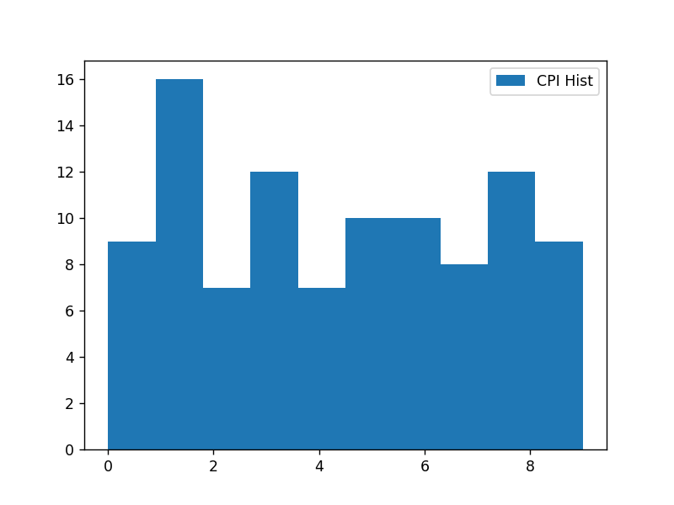
Histograms
Histograms categorize data by breaking it into bins, where each bin contains a subset of the data range.
A Histogram then displays the number of items in each bin so that you can see the distribution of data and the progression of data from bin to bin.
histDemo.py
1
2
3
4
5
6
7
import matplotlib.pyplot as plt
import numpy as np
%matplotlib notebook
cpis = np.random.randint(0,10,100)
plt.hist(cpis,bins=10, histtype='stepfilled',align='mid',label='CPI Hist')
plt.legend()
plt.show()

Slide 46
Boxplots
Boxplots provide a means of depicting groups of numbers through their quartiles.
Quartiles means three points dividing a group into four equal parts.
In boxplot, data will be divided in 4 part using the 3 points (25th percentile, median, 75th percentile)
Interquartile Range
(IQR)
Outliers
Whiskers
Whiskers
Outliers
Minimum
(Q1 – 1.5 * IQR)
Maximum
(Q3 + 1.5 * IQR)
Median
Q1
(25th Percentile)
Q2
(50th Percentile)
Q3
(75th Percentile)
-5
-4
-3
-2
-1
0
1
2
3
4
5

Slide 47
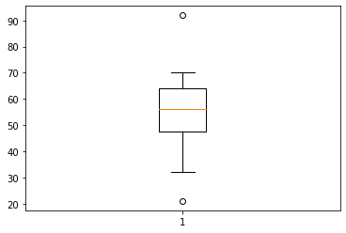
Boxplot (Cont.)
Boxplot basically used to detect outliers in the data, lets see an example where we need boxplot.
We have a dataset where we have time taken to check the paper, and we want to find the faculty which either takes more time or very little time to check the paper.
We can specify other parameters like
widths, which specify the width of the box
notch, default is False
vert, set to 0 if you want to have horizontal graph
boxDemo.py
1
2
3
4
import matplotlib.pyplot as plt
%matplotlib inline
plt.boxplot([50,45,52,63,70,21,56,68,54,57,35,62,65,92,32])
plt.show()

Slide 48
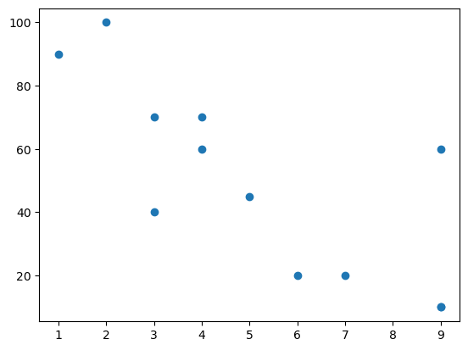
Scatter Plot
A scatter plot is a type of plot that shows the data as a collection of points.
The position of a point depends on its two-dimensional value, where each value is a position on either the horizontal or vertical dimension.
It is really useful to study the relationship/pattern between variables.
now, Consider one terminal which records the speed of the cars.
histDemo.py
1
2
3
4
5
6
import matplotlib.pyplot as plt
%matplotlib inline carAge = [2,5,7,9,4,3,1,9,4,3,6,9]
carspeed = [100,45,20,10,60,70,90,60,70,40,20,10] plt.scatter(carAge, carspeed)
plt.show()

Slide 49
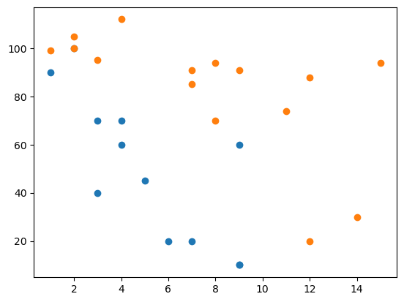
Scatter Plot
Now take days wise observations.
histDemo.py
1
2
3
4
5
6
7
8
9
10
import matplotlib.pyplot as plt
%matplotlib inline # day -1
carAge = [2,5,7,9,4,3,1,9,4,3,6,9]
carspeed = [100,45,20,10,60,70,90,60,70,40,20,10] # day -2
carAge1 = [2,2,8,1,15,8,12,9,7,3,11,4,7,14,12]
carspeed1 = [100,105,70,99,94,94,88,91,91,95,74,112,85,30,20] plt.scatter(carAge, carspeed)
plt.scatter(carAge1, carspeed1)
plt.show()

Slide 50
NetworkX
We can use networkx library in order to deal with any kind of networks, which includes social network, railway network, road connectivity etc….
Install
pip install networkx
conda install networkx
Types of network graph
Undirected
Directed
Weighted graph

Slide 51
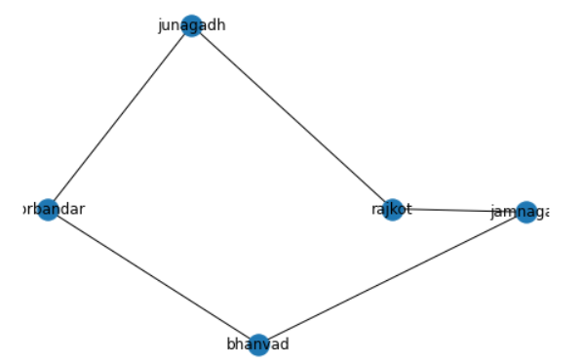
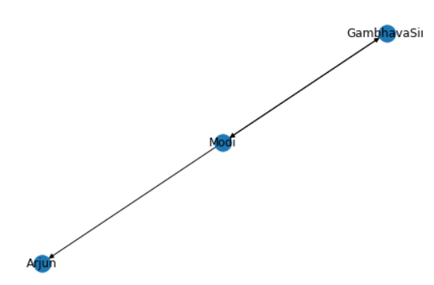
NetworkX (example)
networkxDemo.py
1
2
3
4
5
6
7
8
import networkx as nx
g = nx.Graph() # undirected graph
g.add_edge('rajkot','junagadh')
g.add_edge('junagadh','porbandar')
g.add_edge('rajkot','jamnagar')
g.add_edge('jamnagar','bhanvad')
g.add_edge('bhanvad','porbandar')
nx.draw(g,with_labels=True)
networkxDemo.py
1
2
3
4
5
6
7
import networkx as nx
gD = nx.DiGraph() # directed graph
gD.add_edge('Modi','Arjun')
gD.add_edge('Modi','GambhavaSir')
gD.add_edge('GambhavaSir','Modi')
nx.draw(gD, with_labels=True)

Slide 52
NetworkX (cont.)
We can use many analysis functions available in NetworkX library, some of functions are as below
nx.shortest_path(g,'rajkot','porbandar')
Will return ['rajkot', 'junagadh', 'porbandar']
nx.dijkstra_path(g,'rajkot','porbandar') // will consider weight
Will return ['rajkot', 'junagadh', 'porbandar']
nx.clustering(g)
Will return clustering value for each node
nx.degree_centrality(g)
Will return the degree of centrality for each node, we can find most popular/influential node using this method.
nx.density(g)
Will return the density of the graph.
The density is 0 for a graph without edges and 1 for a complete graph.
nx.info(g)
Return a summary of information for the graph G.
The summary includes the number of nodes and edges, and their average degree.

Slide 53
Choropleth Maps in Python
Choropleth maps are used to plot maps with shaded or patterned areas which are proportional to a statistical variable.
They are composed of colored polygons. They are used for representing spatial variations of a quantity.
Geometric information:
GeoJSON file
this can be built-in geometries of plotly – US states and world countries

Slide 54
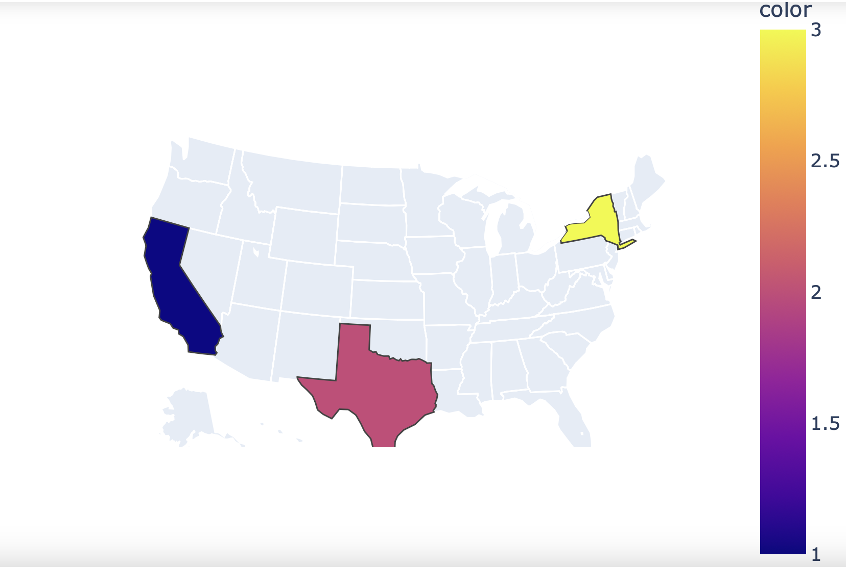
Choropleth Maps in Python
histDemo.py
1
2
3
import plotly.express as px
fig = px.choropleth(locations=["CA","TX","NY"], locationmode="USA-states", color=[1,2,3], scope="usa")
fig.show()

